Slide 1


Amy Schoppman
Director of Government Relations, NMEDA
David Goch
General Counsel, NMEDA

Slide 2

What is NMEDA?
NMEDA members include:
Automobile Manufacturers
Conversion Companies
Automotive Mobility Equipment Manufacturers
Automotive Mobility Equipment Dealers
Healthcare Professionals
on the web @ www.nmeda.org

Slide 3




Original Equipment Manufacturers (OEMs)

Slide 4





Vehicle Conversion Companies
NHTSA FMVSS
CRASH TESTS VERIFIED

Slide 5












Automotive Mobility Equipment Manufacturers
Specialty Seating Systems
Scooter/Wheelchair Lifts
Low Effort Steering/Braking
Mechanical Driving Controls
Electronic Driving Controls
Docking Devices
Securement Systems
Ramps

Slide 6





Healthcare Professionals

Slide 7









Automotive Mobility Equipment Dealers

Slide 8

QAP™ (Quality Assurance Program)
NMEDA’s Quality Assurance Program (QAP) is the only nationally-recognized accreditation program for the adaptive mobility equipment industry.
NMEDA member compliance with FMVSS is mandatory and NHTSA recommends that consumers contact NMEDA to locate a qualified dealer.

Slide 9

Vehicle Conversion Process

Slide 10
Vehicle Conversion Process

Slide 11
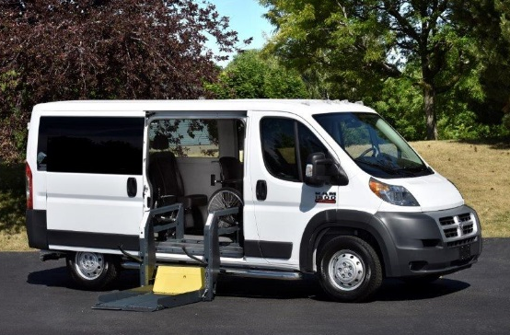
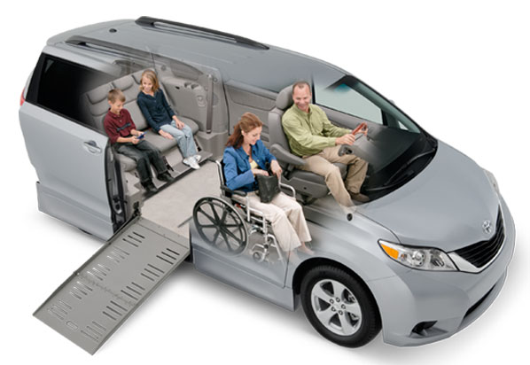
Aftermarket Modifications - RECAP
Lowered Floor

Slide 12
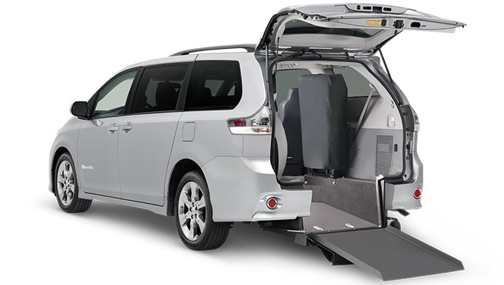
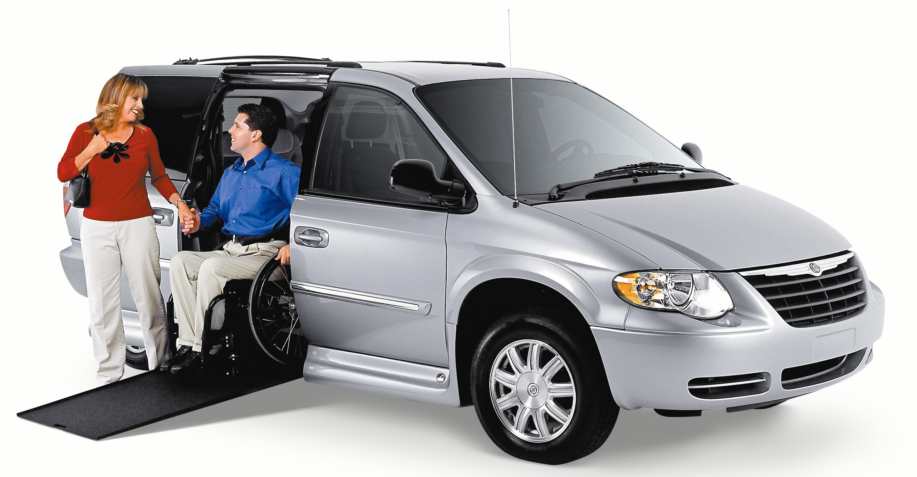
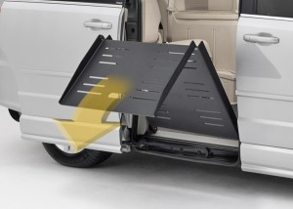
Aftermarket Modifications - RECAP
Ramps

Slide 13
Aftermarket Modifications - RECAP
Kneeling System

Slide 14
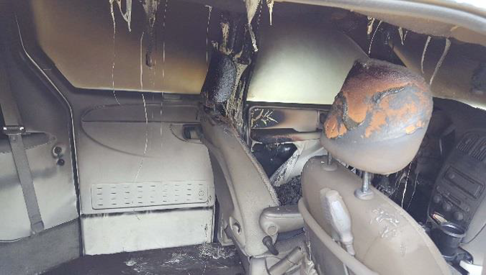
Aftermarket Modifications - RECAP
Suspension, Electrical System, Fuel Tank

Slide 15
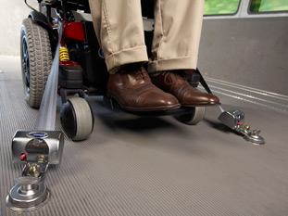
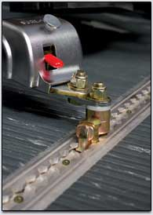
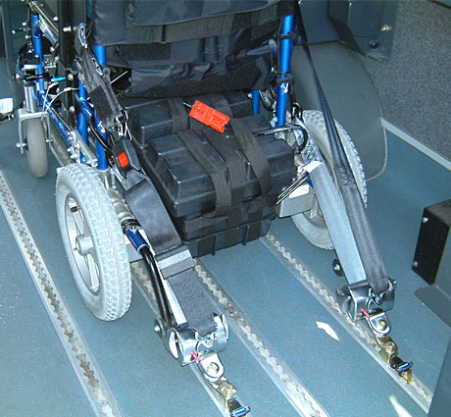
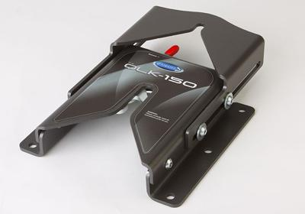
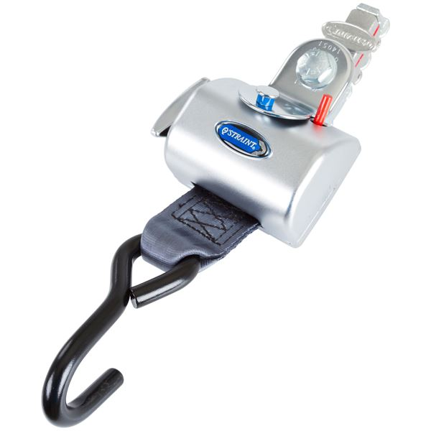
Aftermarket Modifications - RECAP
Wheelchair Securement Systems
F4-point
L-track
Docking Base
Retractable Tie-down

Slide 16
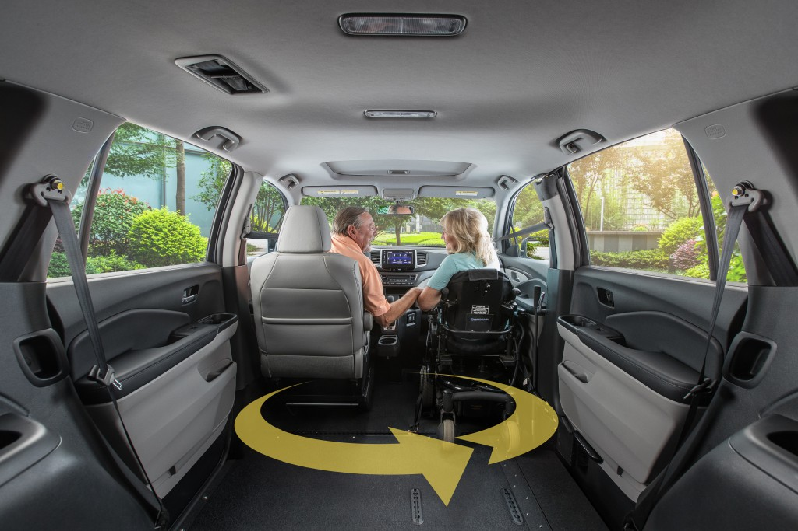
Aftermarket Modifications - RECAP
Interior Touches

Slide 17
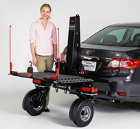
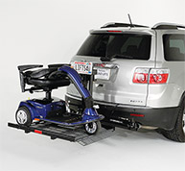
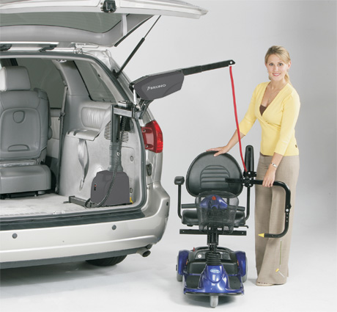
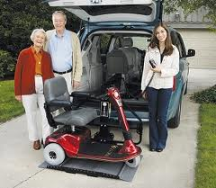
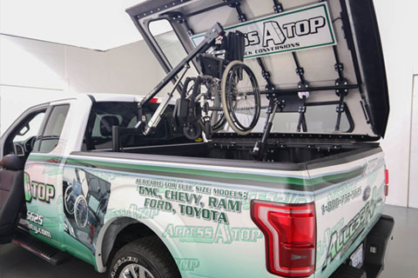
Aftermarket Modifications - RECAP
Lifts and Hoists
Outside Lift for Sedans
Outside Hitch Lift
Hoist
Outside Wheelchair Lifts
Pickup Truck Hoist

Slide 18

FMVSS Make Inoperative Exemptions

Slide 19
Aftermarket/OEM Relationships
Authorized Converter Agreements
OEM provides support, knowledge, product
Conversion Company provides quality assurance, liability protection, brand protection

Slide 20
Opportunities/Challenges
AV Technology (Precision, Security, Acceptance)
Infrastructure
Electric Vehicles
Hands-Free Accessibility
SAFETY

Slide 21
Questions?
Amy Schoppman
Amy.Schoppman@nmeda.org
David Goch
dgoch@wc-b.com

