Slide 1



Amy Schoppman
Director of Government Relations
NMEDA

Slide 2

The trade association for the automotive mobility industry
Dealers, Manufacturers, Healthcare & Assistive Technology Professionals
QAP™ = Quality Assurance Program
Personal, Commercial & Public Transportation
Quality. Safety. Innovation. Customization.
What is NMEDA?

Slide 3



Slide 4
The Promise…
Independence / Quality of Life
Employment Opportunities
Increased Transportation Options
Improved Transportation Experience

Slide 5
The Challenges…
Regulatory Framework
Technology
Manufacturing
Public Trust
Safety
Integration
Scale
Cost
Licensing/Permitting
Liability/Insurance
Infrastructure
Accessibility
Proliferation

Slide 7


Kevin Frayne
Director of Advanced Mobility Solutions
BraunAbility

Slide 8
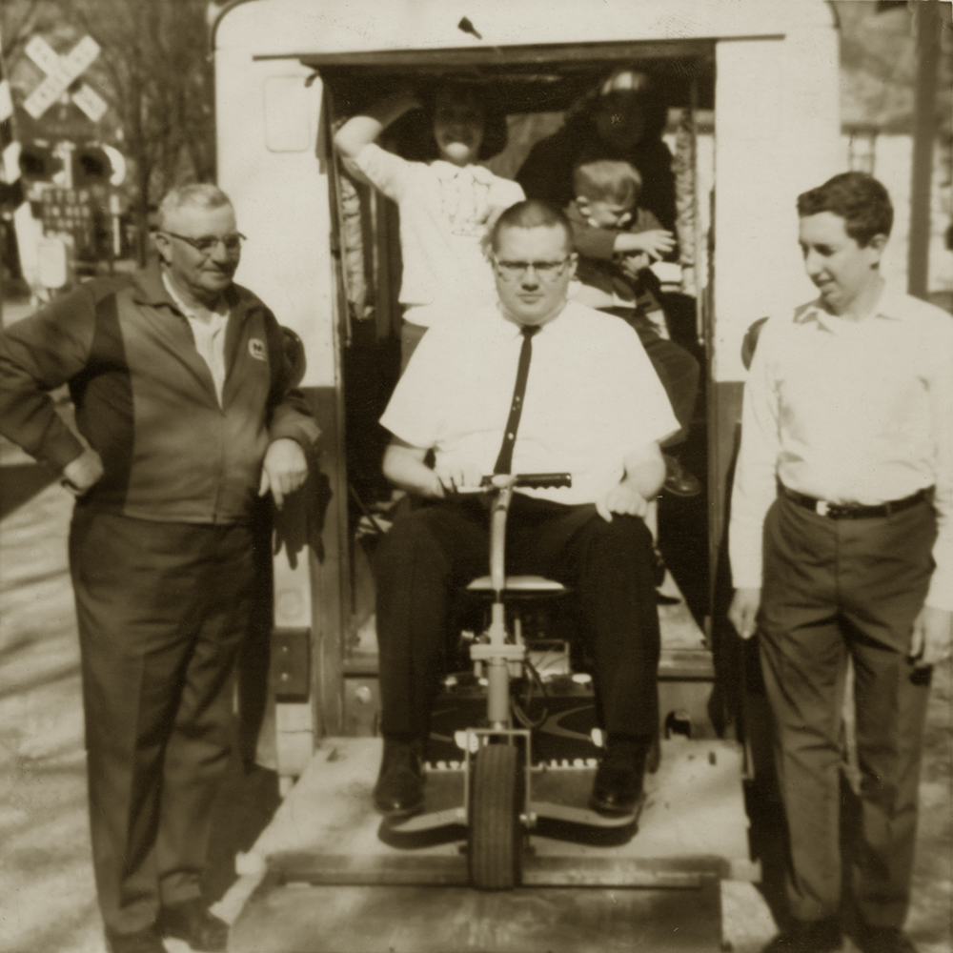
Accessible Conversion Industry = Born of Necessity
Ralph Braun
Father of the Mobility Movement
Diagnosed in 1947 with muscular dystrophy.
Engineered the first battery-powered scooter and designed the first wheelchair lift - installed in an old postal truck.
In 1972 he established The Braun Corporation, which is today known as BraunAbility.

Slide 9
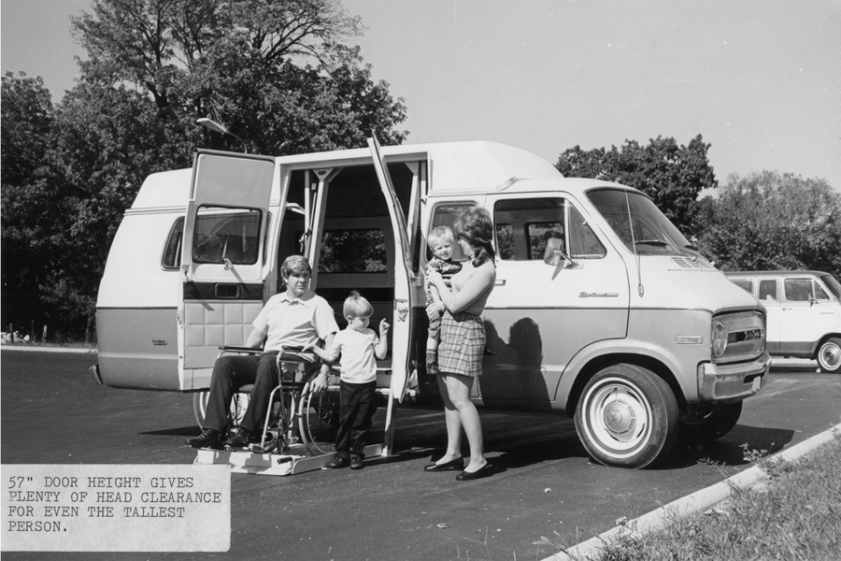
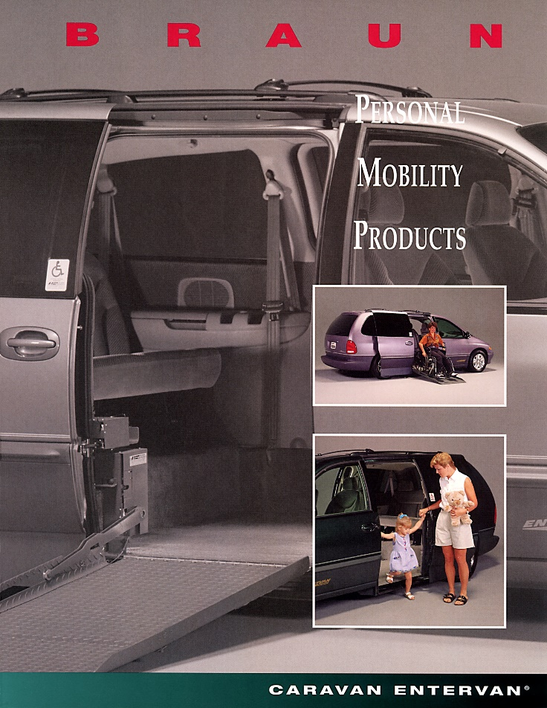
Conversions Evolved with the Auto Industry
…To Meet Customer Preferences

Slide 10

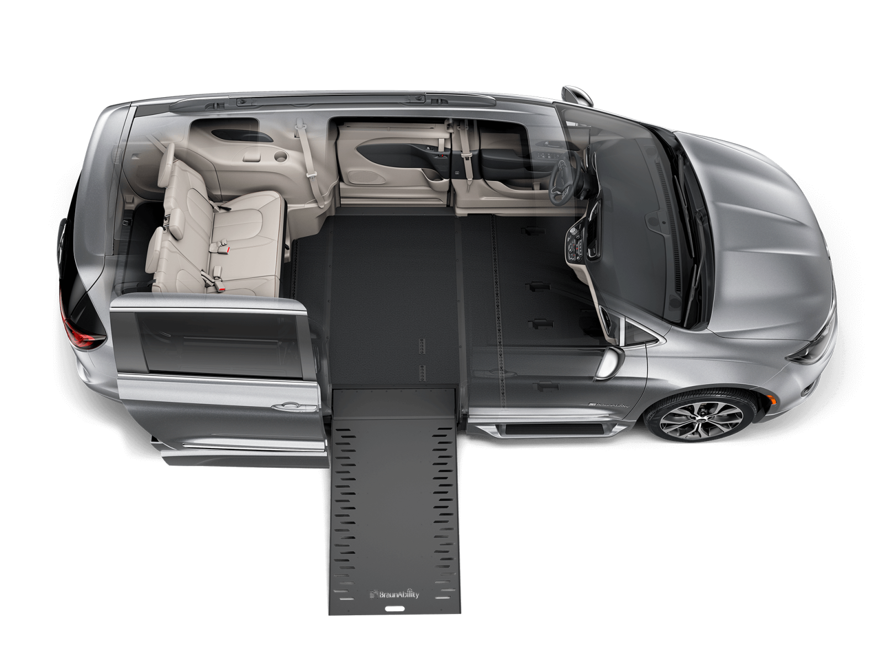
What Makes a Vehicle Wheelchair Accessible?
Door Opening
  Width: 30 in.
  Height: 56 in.*
Ramp
  Width: 30”*
  Side Rail Height: 2 in.*
  Angle: 1:4
  Capacity: 600 lbs.
  2 foot-candles of illumination on
  threshold
Interior
  Height: 56 in.*
  Width: 30 in.* for wheelchair location
  Slip-resistant flooring
  Room to maneuver into position
Other
  Gearshift Interlock
  Wheelchair & Occupant Restraints
  Hand Controls
* ADA requirement

Slide 11
What Makes an AVehicle Wheelchair Accessible?
Door Opening
  Width: 30 in.
  Height: 56 in.*
Ramp
  Width: 30”*
  Side Rail Height: 2 in.*
  Angle: 1:4
  Capacity: 600 lbs.
  2 foot-candles of illumination on
  threshold
Interior
  Height: 56 in.*
  Width: 30 in.* for wheelchair location
  Slip-resistant flooring
  Room to maneuver into position
Other
  Gearshift Interlock?
  Wheelchair & Occupant Restraints
  Hand Controls?
* ADA requirement

Slide 12



A LOT of Personalization Exists Beyond the Basics...
Minivans
Vehicle Make & Model
Interior Height
  Different lifts/drops based on customer need.
Wheelchair Location
  Driver, Passenger, 2nd Row, or 3rd Row?
Entry
  Side or Rear?
Ramp
  In-Floor or Folding?
  Power or Manual?
Type of Wheelchair
  Manual, Power, Transfer, or Mobility Seating (Turny Evo)?
Wheelchair Securement
Etc.
100%
477k Total U.S Minivan Registrations*
0.5%
~15k Wheelchair
Accessible Vehicles
*Source: IHS 2018CY Registrations

Slide 13
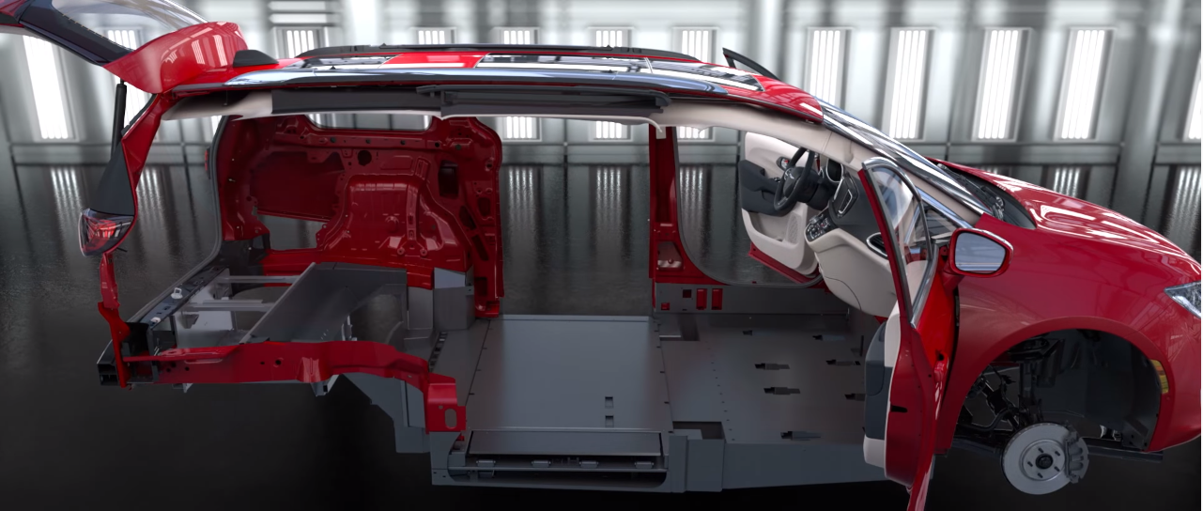
Major Vehicle Systems are Reengineered and Recertified
FMVSS 110 Tire Selection and Rims
FMVSS 126 Stability Control
FMVSS 134 Passenger Car Brake Systems
FMVSS 207 Seating Systems
FMVSS 208 Occupant Crash Protection
FMVSS 201 Seatbelt Assembly Anchorages
FMVSS 214 Side Impact Protection
FMVSS 225 Child Restraint Anchorages
FMVSS 301 Fuel System Integrity
CARB Emissions
NHTSA 567 Certification

Slide 14
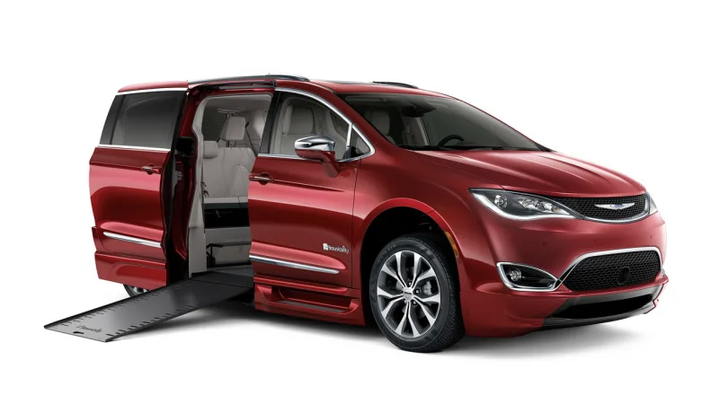
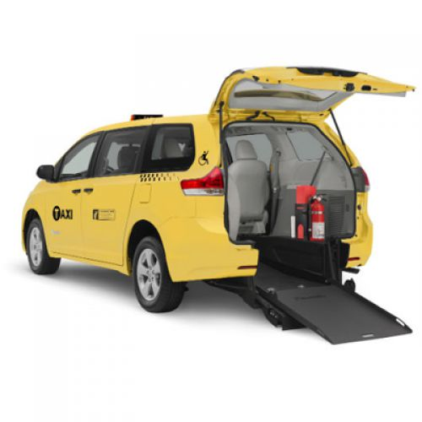
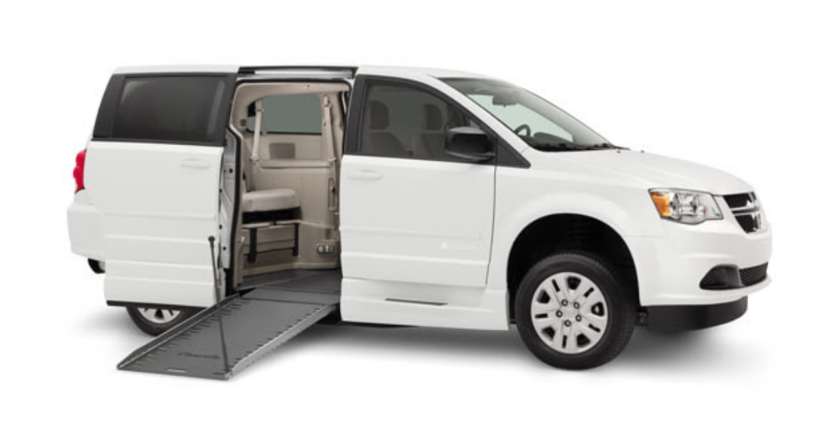
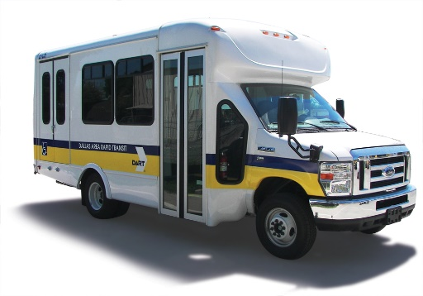
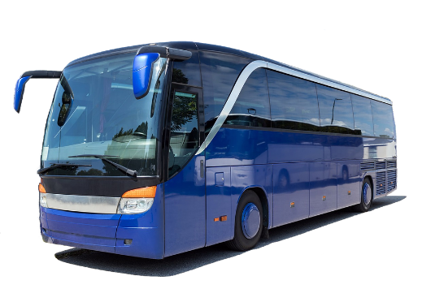
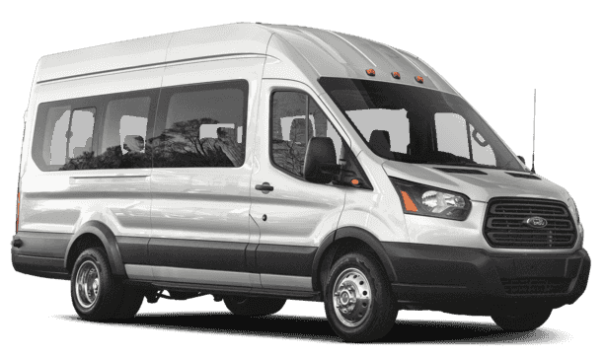
Different Segments, Different Customers, Different Needs…
Different Paths to Autonomous Vehicles
Personal Use / Ownership
Wheelchair users and caregivers.
Minivans dominate due to their functionality.
Commercial / Private
Retirement communities, university campuses, airport shuttles, private transit, etc.
Minivans, full-size vans, cutaways/buses, coaches, etc.
Government
Public Transit authorities, VA hospitals, Entities using public funding, etc.
Minivans, full-size vans, cutaways/buses, etc.

Slide 15
Different Segments, Different Customers, Different Needs…
Different Paths to Autonomous Vehicles
Personal Use / Ownership
Commercial / Private
Government
Shared Ownership?
Car Sharing?
Ride Sharing?
Personal Ownership?
Transit?
Fixed Route?

Slide 16

AVs can be an Accessibility Game Changer
AV / EV architectures and/or new design paradigms need to consider a wheelchair user’s unique and varied AV necessities.
  We’re a long way from a One-Size-Fits-All Solution.
Continued OEM cooperation with conversion/upfit industry will ensure wheelchair users are provided options/variety while still allowing for individual customization.
  Consult with WAV experts – accessibility may not currently be top of mind.
Wheelchair Users Just Want to Be Transported Like Anyone Else
  Provide choice/variety, options for personalization/customization –
  not a homogenous demographic.

Slide 17


Ovidius Turcanu
R&D Manager
Q’STRAINT

Slide 18
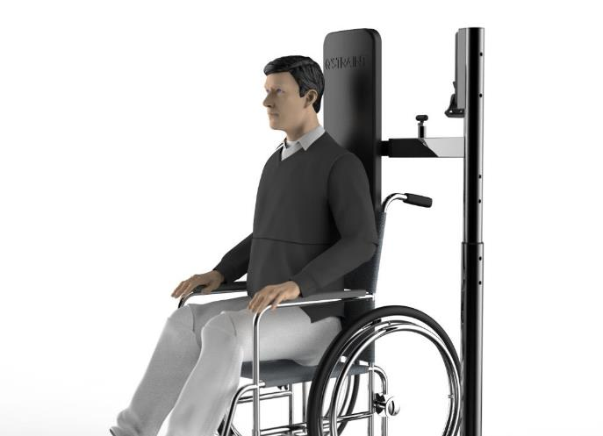
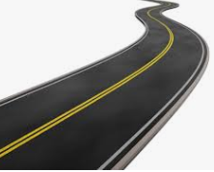
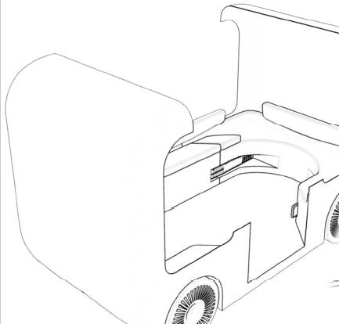
Autonomous Vehicles & Wheelchair Securement
Ride inquiring
Ride confirmation (free securing station)
Pickup location
Boarding
Securement / Un-securement
Un-boarding
Ride complete
During the ride process there are a lot of communications / interactions from the moment of inquiry until the ride is complete. Based on various external factors, the autonomous vehicle will make decisions in order to ensure a safe and secure transportation method.

Slide 19
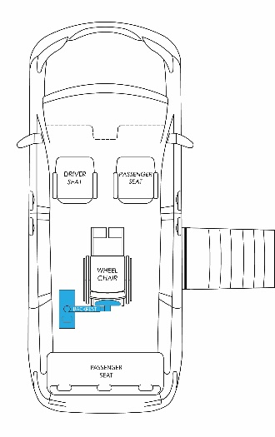
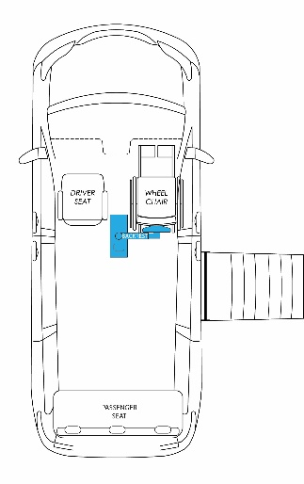
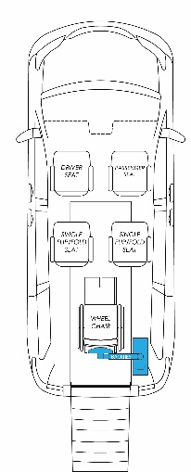
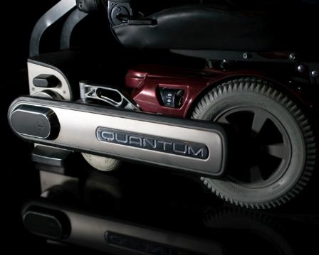
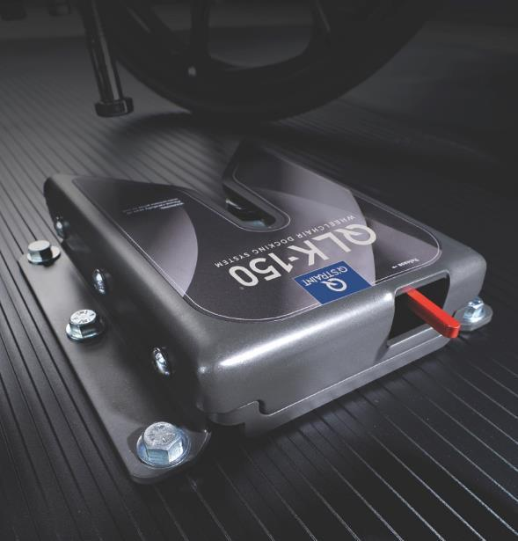
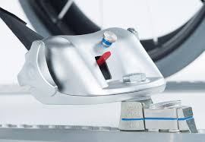
Overview of WC Securement Systems
The current personal mobility market allows for different methods of WC
securement. Each of these WC securement methods need to be used with a
passenger securement solution.
WC securement types can vary regarding function of WC positions or
passenger needs.
The passenger securement is currently a manual process.

Slide 20
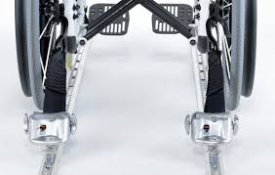
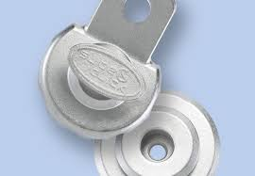
Personal Transportation – Wheelchair Tie-Down
Wheelchair Tie-Down Benefits:
Compatible with all mobility device types
Meets requirements for RESNA WC-4 for vehicles <11,000 lbs
Meets WC-18 standard
Wheelchair Tie-Down Challenges:
Attendant is required for proper securement
Passenger restraint is not independent
Restraint confirmation is based on attendant

Slide 21
Personal Transportation – Docking System
Docking System Benefits:
System adapted to the most popular WCs on the market
Meets requirements for RESNA WC-4 for vehicles <11,000 lbs
Fully independent docking and undocking
Docking System Challenges:
All WC users require mating bracket (custom chair)
Passenger restraint is not independent

Slide 22
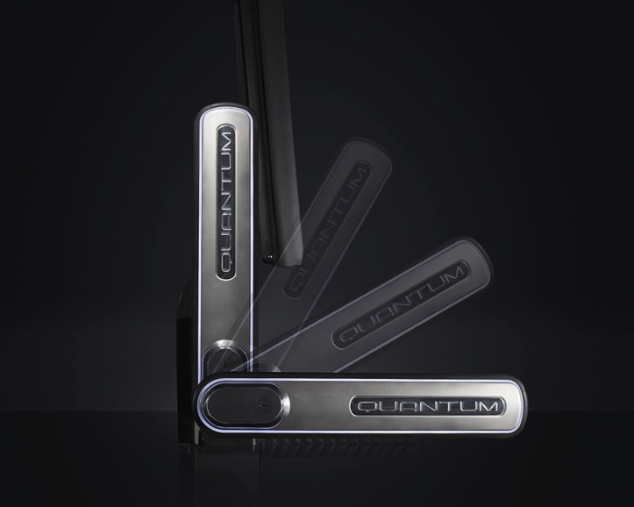
Personal Transportation – Autonomous Station
Autonomous Station Benefits:
Compatible with all mobility device types
Meets requirements for RESNA WC-4 for vehicles >11,000 lbs – for rear facing transportation
Attendant is not required for proper securement
Autonomous Station Challenges:
Station is rear facing
Passenger restraint is not independent
Cost

Slide 23
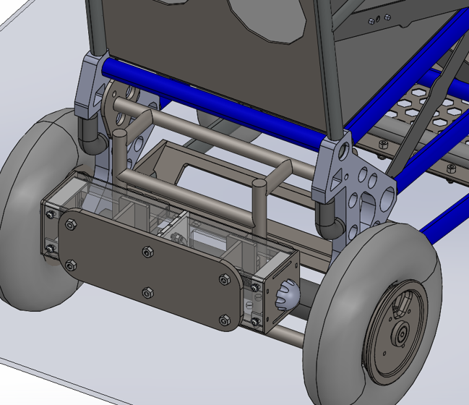
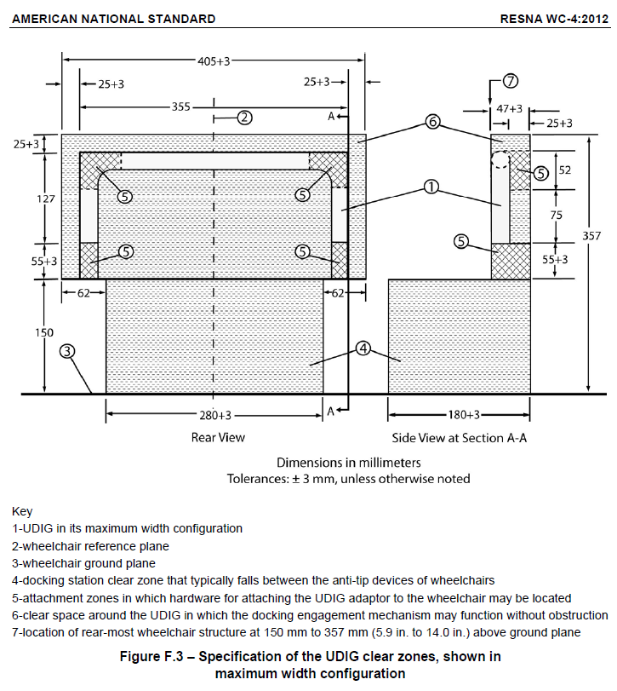
Personal Transportation – Autonomous Station
Autonomous Station Benefits:
Compatible with certain mobility devices
Meets requirements for RESNA WC-4 for vehicles <11,000 lbs
Attendant is not required for proper securement
Autonomous Station Challenges:
WC standardization
Passenger restraint is not independent
Cost

Slide 24
Personal Transportation – AV Wheelchair Securement
WC configuration
Independent Use

Slide 25
Challenges to Overcome:
There are thousands of different mobility device designs (this includes WCs and scooters)
Existing mobility device design standards are insufficient
Safety testing standards for AVs are currently undefined
Will the market pay for a fully independent WC/mobility device securement system?
When will fully independent WC/mobility device securement systems be necessary?
Structural base/floor strength of AV must be considered in order to achieve WC/mobility device securement, load distribution

